Slide 1


A Brief Look at the Internet of Everything
Michael Gentile
Notes:
Opening slide - abstract
As many of you may instantly recognize, the theme playing in the background is Star Trek. My father introduced me to science fiction through Star Trek when I was a young boy. The theme music meant it was time to get comfortable on the couch and settle in for the latest episode.
I was amazed at the technical possibilities it created. Communicators, tricorders, and replicators promised the potential of a new age for humanity. I was not sure at the time if I expected to be living at the dawn of the realization of those advancements. But I am and can’t wait to see what comes next with internet 3.0.

Slide 2



Objectives
Review the Internet of Things
Discuss the Internet of Everything & It's Four Pillars
Talk About How It's Being Accepted, Growing and Trends It's Creating
Assess Security Concerns Created
Consider Ethical Issues Needing to Be Addressed
Notes:
Slide 2 - introduction
In my previous life as an electrician, the greatest advancement I witnessed was the battery-powered tools. These tools freed tradesmen from being tethered to extension cords all day but were a far cry from the technology at work around us every day. So given a chance to explore these new fields, I decided to take a closer look at The Internet of Everything.
The Internet of Everything connects the internet of things to the user, changing the human experience through processes that create relevant connections. Together we will explore the internet of everything by reviewing the internet of things against the internet of everything and briefly reviewing its acceptance, growth, and trends. Then we will discuss security and ethical concerns that users should be aware of. Through this, we will understand where we are headed and why the internet of everything is important.

Slide 3


The Internet of Things
The Interconnection of Devices or Objects Through the Internet
Collect and Produce Data that is Shared for Other Objects to Use
Notes:
Slide 3 - The internet of things
Let’s start by reviewing what the internet of things is. The definition of the internet of things is the interconnection of devices or objects through the internet. Essentially any object connected to the internet is part of this. These objects then collect and produce data that is shared across the internet for other objects to use.
These objects include vehicle remote start systems, smart plugs and switches, sensors for conveyor belts, and even alarm or security systems. Remember, any object that can connect to the internet is part of the Internet of things.

Slide 4
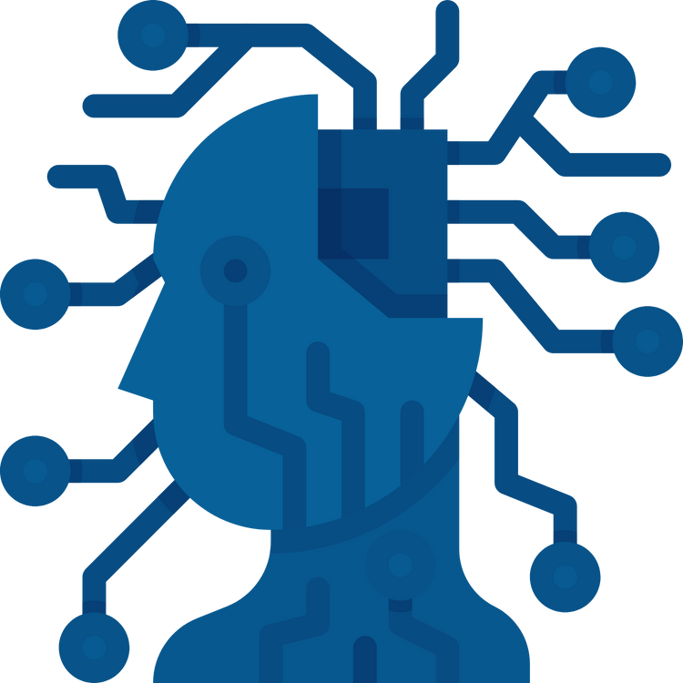
The Internet of Things
Artificial Intelligence and Machine Learning are Part of the Internet of Things
64 Billion Devices and Objects by 2026
Notes:
Slide 4 – Cont.
This also means that systems developed for artificial intelligence and machine learning are part of the internet of things because they are connected to the internet and can transmit data from object to object.
The internet of things is expected to include over 64 billion devices and objects by 2026, and will assist in business planning, resource management, and improving job safety.

Slide 5



Internet of Everything
Explained Through the Four Pillars that Create Its Structure:
People
Things
Data
Processes
Combines the Internet of Things With the Human Perspective
Notes:
Slide 5 – The internet of everything
Next, let’s look at the Internet of everything. The internet of everything combines the Internet of things with the human perspective to consider the interaction of the 2. In other words, it was first important to understand the internet of things because the internet of everything is built on top of it.
This is best explained by exploring the structure of the internet of everything through the four pillars that create its structure of it. These pillars are People, things, data, and processes. Through this pillar structure, the internet 3.0 has a solid foundation by which we experience the internet of everything.

Slide 6

Internet of Everything
The Who
Identifies How the User Engages the IoE
Level of Expected Engagement
The Where
Objects Connected to Internet
Provides User Experience
People
Things
Notes:
Slide 6 – Pillars 1 & 2
Looking at the first two pillars, people and things, provides the who and where of the internet of everything. This is the basis for how the internet of everything acquires and focuses its goal on providing a user experience.
People – this identifies how the user engages in the internet of everything and to what extent that engagement is expected. For instance, if a user has a smartwatch, the uses engage with the watch, and the extent of engagement is limited to the applications provided by the watch
Things – as previously mentioned, these are the objects connected to the internet. They provide the actual user experience and provide insight into how the user expects to use the internet of everything. Back to our watch example, the user experience is defined by the watch’s capabilities, and the expectations are the applications the user downloaded to the watch.

Slide 7
Internet of Everything
The What
Gathering of Information
Often Raw and Unprocessed
The How
Analyze All the Data Collected
Provides User with Desired Information
Data
Process
Notes:
Slide 7 – Pillars 3 & 4
The next two pillars, data and processes, define the what and how of the internet of everything. This is the collection and use of information that is gathered from the first two pillars.
Data is the gathering of user-provided information or device-acquired information. This is often raw and unprocessed and may be unusable in its original form. Using our smartwatch example, consider the information provided by the user when signing up for an application and the data allowed to be collected by accepting the user agreement that the application collects through the device operation.
Process is the next step. Advanced AI systems and machine learning processes then analyze all the data collected with consideration of user expectations. This provides the user with the desired information, such as an exercise application on a smartphone supplying the user with their target heart rate to lose a desired amount of calories during an activity.

Slide 8


Acceptance, Growth & Trends
5G is providing a way to increase traffic
Better Networks are needed
Increased Storage & ways to determine what is stored
New methods using AI and Machine Learning can provide help
Growth expected of $35 trillion by 2040
Notes:
Slide 8 – Acceptance, growth, trends
However, due to concerns over network availability and storage of data, acceptance is limited until better networks are deployed and larger and smarter facilities are provided to handle the this emerging market.
This is driving the trend to support the growth of 5G networks and prevent bottlenecks for data collection.
It’s, also, expanding the capabilities of AI and machine learning to develop methods of determining what information to store and how it should be stored.
But this market is expected to add 35 trillion dollars to the marketplace by 2040 due to industrial and manufacturing acceptance and new device development.

Slide 9

Devices
Protections can't be built in due to small form factor of most devices.
Storage
Decentralization can allow breaches and illegal dissemination of private information.
Security Issues
Ownership
Annoymous data ownership is still in contention even with regulation.
Notes:
Slide 9 - Security Concerns
Security is essential to the internet of everything. But small devices prevent protections from being built in, and decentralization of data allows for vulnerabilities, such as breaches and illegal dissemination of information. Additionally, is a concern about data ownership. Although regulations, like GDRP, require consent for data usage, concern still exists with anonymous data and whether measures are required to keep it secure.
But as newer networks and intelligent warehouses are being built, these concerns are being discussed, and advancements in better security are being developed alongside the growth of the internet of everything.

Slide 10

Privacy
Ethical Concerns
Employee tracking and monitoring is creating concerns oh how this technolgy should be used and when surveilance should be ended.
Privacy
New studies show these conditions are creating unhealthy work environments
Privacy
Significant investments are still being made by organizations into developing new technology to surveil employees
Notes:
Slide 10 – Ethical Concerns
Ethical concerns for data on the internet of everything are mainly about privacy and how the data should be used. Some of these concerns stem from employers monitoring and tracking employee activity, possibly during non-business hours. Studies have shown that this type of activity can cause demoralization of the workforce and potential health-related issues for employees. Still, due to potential productivity increases, more devices are being built to surveil employee behavior.
However, as more information is gathered and analyzed, these concerns will need to be addressed and new privacy policies created for how data can be used on the internet of everything.

Slide 11

Summary
The Internet of Everything is Built on Top of the Internet of Things
The Internet of Everything is Currently being Adopted, and New Technology is Supporting this Change
Security Flaws are Inherent in Some Devices and Decentralization Presents Additional Risk
Privacy Concerns Still Need to be Addressed
Notes:
Slide 11 – Conclusion
As we wrap up our talk keep in mind these points
The internet of everything is built on top of the internet of things
The internet of everything is being adopted, and new networks and advancements are being built to support this change
Security flaws may be inherent in some devices, and decentralization may present additional risk
Finally, ethical concerns about privacy need to be addressed.
Like the stories of the science fiction shows and movies my father and I watched together, the world is becoming smaller and interconnected through the innovations driven by the IoE. As more of those technologies become a reality, more will be dreamt of and shared across this internet iteration, driving even more understanding and connection for the next. It is exciting to imagine where we are headed next.

Slide 12
Bibliography
Antoniou, A., & Andreou, A. (2019). Case Study : The Internet of Things and Ethics. ORBIT Journal, 2(2). doi:https://doi.org/10.29297/orbit.v2i2.111[/vc_column_text][/vc_column][/vc_row]
Courage, A. (1969). Theme from Star Trek. United States of America.
Inc, C. (n.d.). All photos were stock images provided by Canva Inc. Canva Inc.
Kumar, R., Narayanan, S., & Kaur, G. (2021, April). FUTURE OF INTERNET OF EVERYTHING (IOE). International Research Journal of Computer Science (IRJCS), 8(4), 84-92.
Meola, A. (2022, April 15). What is the Internet of Things? What IoT means and how it works. Retrieved from https://www.insiderintelligence.com/: https://www.insiderintelligence.com/insights/internet-of-things-definition/
Rastogi, H. (2022, January 26). Internet of Everything (IoE): 4 Pillars of IoE. Retrieved from analyticssteps.com: https://www.analyticssteps.com/blogs/internet-everything-ioe-4-pillars-ioe
Sakovich, N. (2019, Feb 6). What Is the Internet of Everything (IoE)? Retrieved from Sam Solutions: https://www.sam-solutions.com/blog/what-is-internet-of-everything-ioe/
Transparency Market Research, Inc. (n.d.). Internet of Everything (IoE) Market. Retrieved from Transparency Market Research: https://www.transparencymarketresearch.com/internet-of-everything-market.html
TWI LTD. (2022). WHAT IS THE INTERNET OF THINGS (IOT)? Retrieved from TWI: https://www.twi-global.com/technical-knowledge/faqs/what-is-the-internet-of-things-iot

